Slide 1
IBM Capstone Project The Battle of Neighborhoods
By Debesh Roy
17Aug2020

Slide 2
Index
Introduction
Background
Data
Methodology
Results
Discussion
Conclusion
The Selection of Neighborhoods for Staying in a suitable location in Madrid
Applying Data Science using Python & Machine learning to identify the suitable place within surrounding areas

Slide 3
Introduction
Due to the present era of Globalization, people are moving around the globe, knowing or without
knowing much about the destination and surrounding neighborhoods, where they are planning to
stay for some time – months to years.
This project made keeping in mind Madrid, Spain as a destination, where people are planning to visit
Madrid in near future – either for short span or long period.
One can use this Python notebook, by changing the parameter, can browse through the Madrid Districts
and Wards, will get to know about the surrounding venues and their categories, nearby locations, etc.
Point to be noted, this project and data analysis will guide to identify the right location to stay, based on
personal preference, but will not suggest the Good or Bad neighbor. The decision totally depends on
personal interest, whether s/he is looking for School or College, trade off between Shopping Mall and
Supermarket, preference between Candy Store and Ice Cream Shop, looking for Restaurant or Bar,
and many more.

Slide 4
Background
Madrid is the capital and most populous city of Spain. The city has almost 3.3 million inhabitants and
a metropolitan area population of approximately 6.5 million. It is the second-largest city in the European
Union (EU), surpassed only by Berlin, and its monocentric metropolitan area is the second-largest in the
EU, surpassed only by Paris. The municipality covers 604.3 km2 (233.3 sq mi).
Madrid is a city of elegant boulevards and expansive, manicured parks and many more. It’s renowned for
its rich repositories of European art, including the Prado Museum’s works by Goya, Velázquez and other
Spanish masters. The heart of old Hapsburg Madrid is the portico-lined Plaza Mayor, and nearby is the
baroque Royal Palace and Armory, displaying historic weaponry.
In this project we will try to find a suitable locations for staying, who is planning to relocate to Madrid for
some time, based on his/her personal preferences of the surrounding neighborhoods and available venues.
We will use the data science mechanism to generate more information about the nearby venues and
whereabouts, which will help stakeholders or interested people to take the decision and plan accordingly.

Slide 5
Data
The related information about Madrid got downloaded from Wikipedia,
i.e. https://en.wikipedia.org/wiki/Districts_of_Madrid
We extracted info like District, Area, Population, Density, corresponding Wards from the Wiki,
and the Venue & Category details using Foursquare URL https://foursquare.com and corresponding APIs.
The process used data Extraction from the wiki, Transformed based on the need of this analysis, and
Loaded into pandas DataFrames.
Let us find some data extraction sample in subsequent slides.

Slide 6
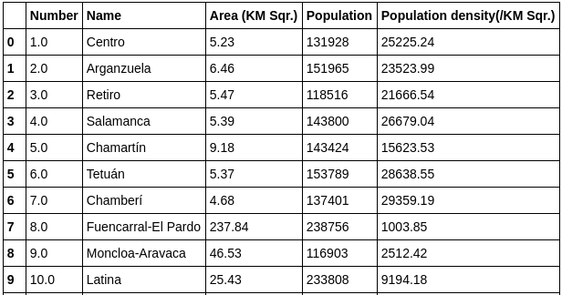
Data.....continued
List of Districts:

Slide 7
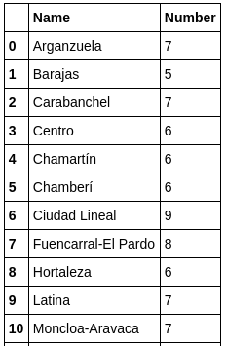
Data…..continued
District wise Ward count:

Slide 8
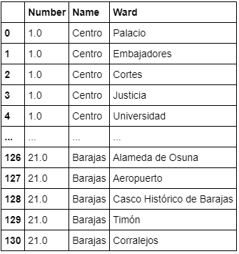
Data…..continued
District wise Ward list:

Slide 9
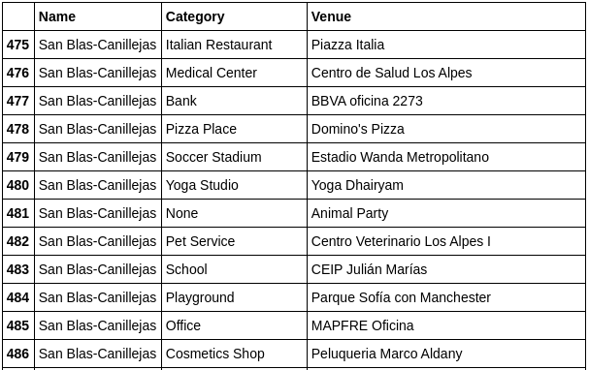
Methodology
The base of the project is Python, where we extensively used multiple important libraries, i.e. pandas,
numpy, geocoder, folium, and many more. Each one of the used library is having dedicated purpose.
Used pandas’ “read_html” to read the information from wiki URL. Used DataFrame feature extensively
to handle data, i.e. transforming, cleansing, etc.
This data handling helps to identify the District wise Ward wise Venue and the Category.

Slide 10
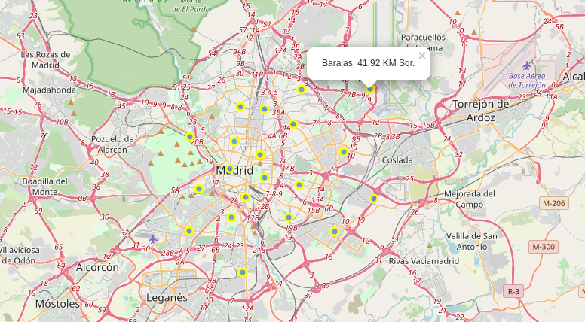
Methodology…..continued
Used Florium map feature, which will help interested stakeholder to identify the surrounding
venues, categories, neighborhoods, etc.

Slide 11
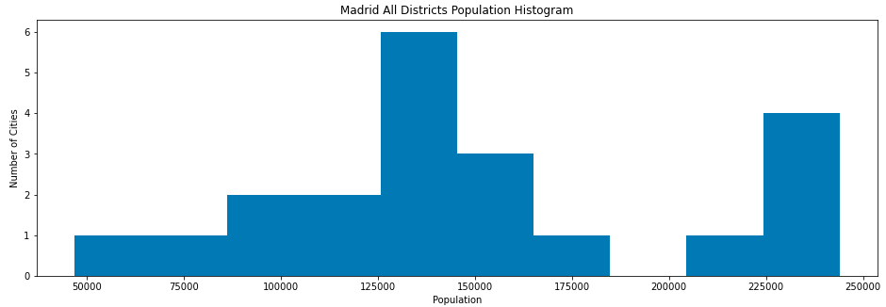
Methodology…..continued
Used numpy Histogram plot to show the Population histogram for all Madrid districts:

Slide 12
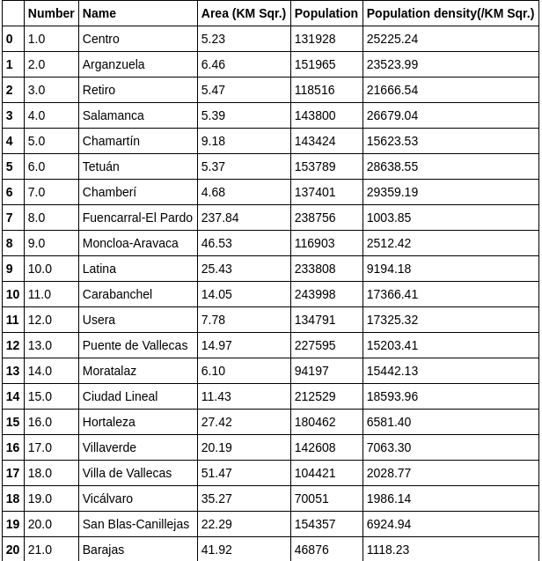
Result
Using the Python and corresponding libraries, we identified that there are 21 districts in Madrid, along
with the corresponding area, population and density.

Slide 13
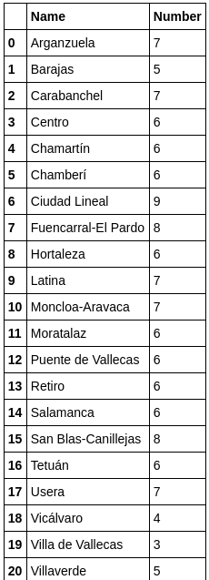
Result…..continued
We also identified that each district is having on an average 6~7 wards.

Slide 14
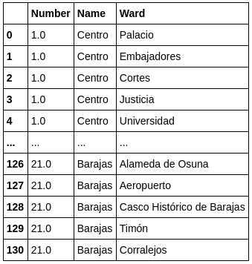
Result…..continued
And the corresponding wards for each district

Slide 15
Discussion
Well, the purpose of this Python notebook is to identify the suitable location to stay. The tool will not
suggest the Good or Bad neighbor, but based on personal interest, whether you are looking for School
or College, trade off between Shopping Mall and Supermarket, preference between Candy Store and Ice
Cream Shop, looking for Restaurant or Bar, and many more.
Along with the data point, from the Florium map one can also identify the near around venues and
approx. distances.

Slide 16
Conclusion
It’s always preferred to have a careful consideration before selecting a neighborhood, where one is
going to stay for some time. Though this report will not decide the best place but it’s up to individual
choice to finalize.
After going through the detailed analysis between districts, wards and areas, once can easily get a fair
knowledge on the surroundings and can conclude. Based on that, s/he can either put on advertise on the
local media, or just can pay a visit to feel the ambience of the place.

Slide 17


